Slide 1
Inventory Management Systems

Slide 2
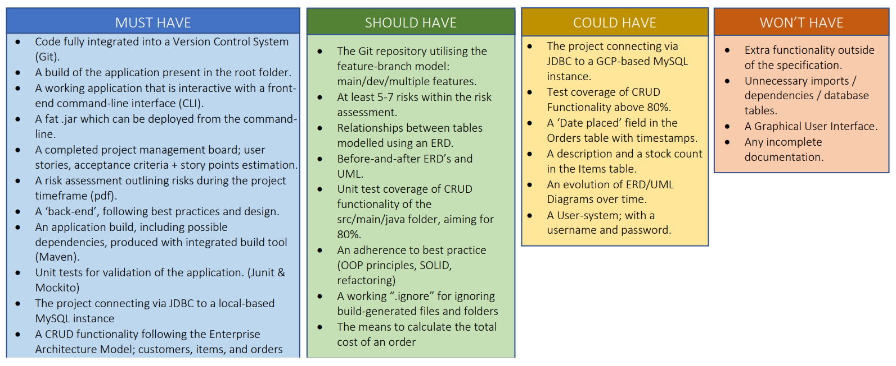
MoSCoW Prioritisation

Slide 3
Risk Assessment

Slide 4
Entity Relationship Diagram (ERD) - Initial & Final

Slide 5
Unified Modelling Language (UML)

Slide 6
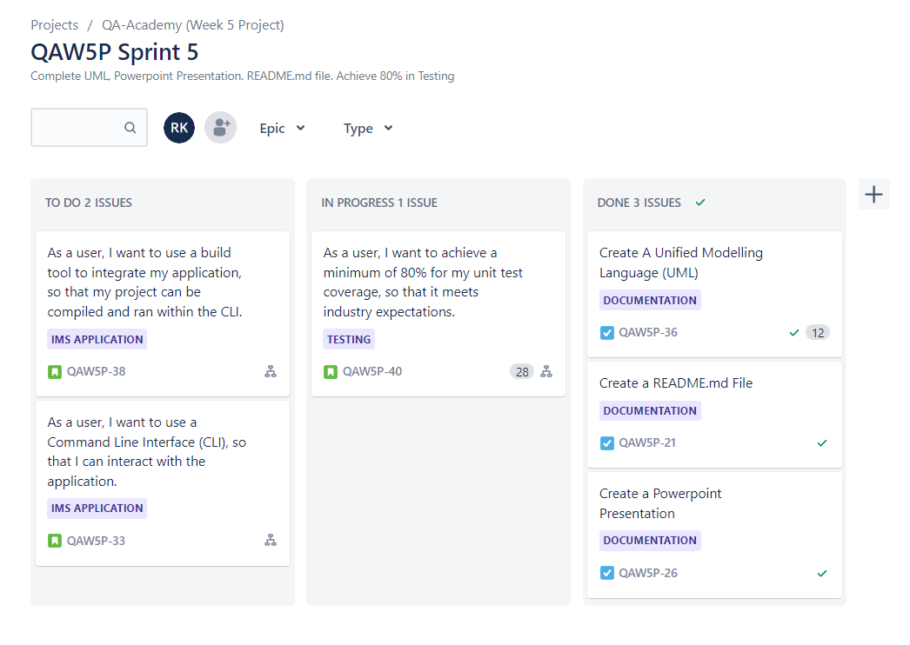
Jira Board – Sprints

Slide 7
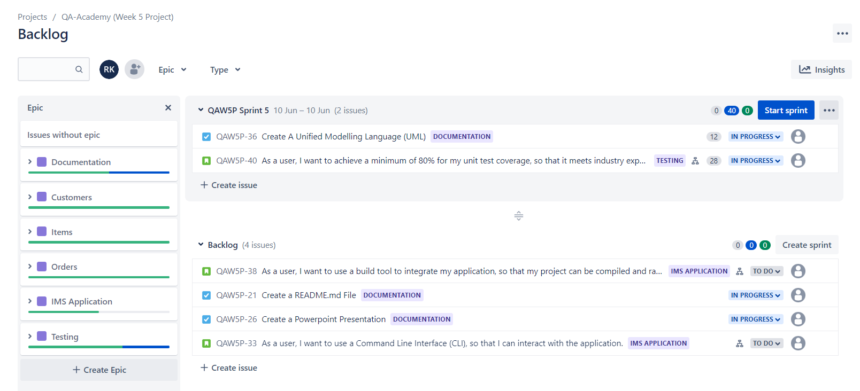
Jira Board – Epics/User Stories/Acceptance Criteria/Tasks

Slide 8
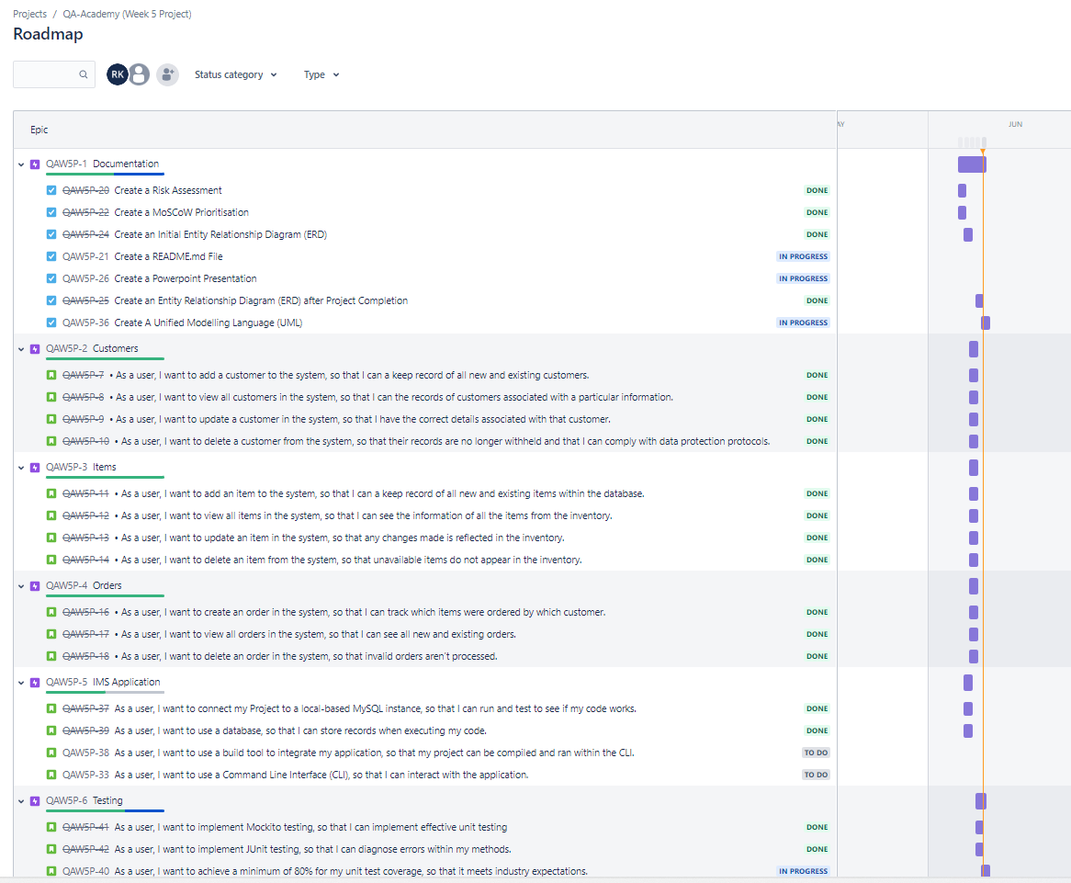

Slide 9
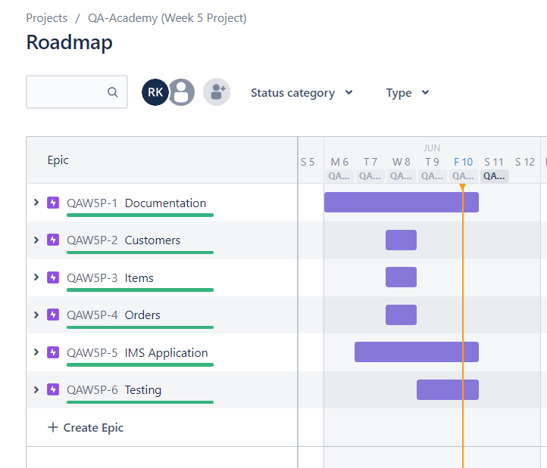

Slide 10
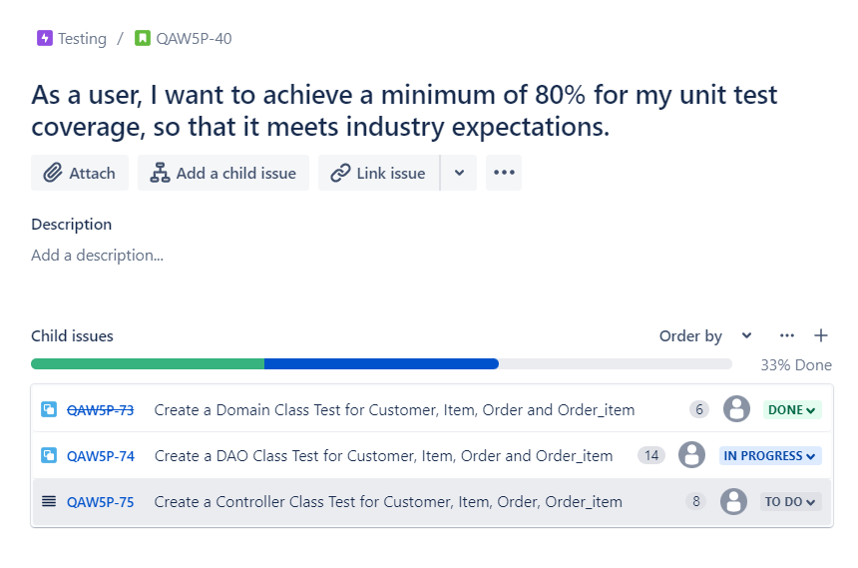

Slide 11
Version Control – Feature Branch Model (FBM)

Slide 12
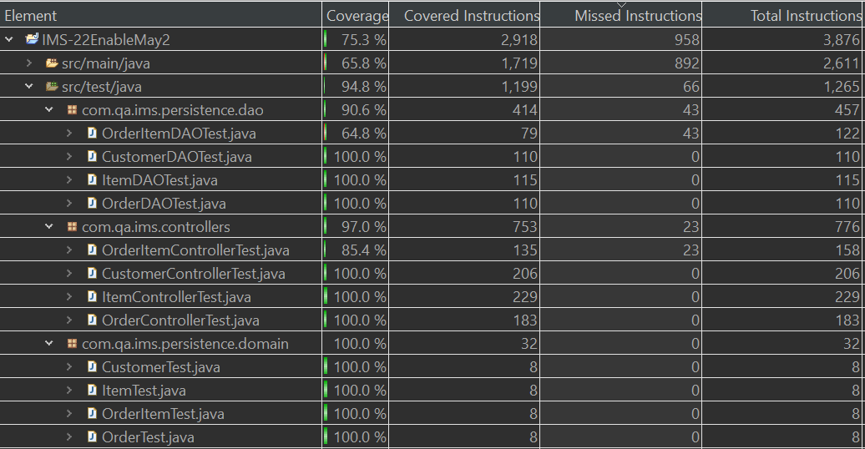
Test Coverage

Slide 13
Sprint Review

